Slide 1
LILAC: Working for Justice in Policing Practices and Policies
Lessons from the Department of Justice’s Supervision
of the Suffolk County Police Department
Nancy Trasande
Senior Counsel
www.latinojustice.org
212.219.3360
99 Hudson Street
New York, NY 10013

Slide 2
DOJ Supervision Timeline
Sept. 13, 2011: Technical Assistance Letter.
Nov. 14, 2012: Suffolk County Executive Steve Bellone signed Executive Order 10-2012, ordering language assistance services (translation and interpretation) to people of Limited English Proficiency (“LEP”) at executive county agencies that provide direct public services.
Dec. 2013: Limited settlement agreement reached with the SCPD.
Jul. 14, 2014: First Compliance Report.
Jan.13, 2015: Second Compliance Report.
Aug. 1, 2015: Third Compliance Report.

Slide 3
Technical Assistance Letter (“TAL”): Problems Identified in Suffolk County
SCPD policies required questioning a person arrested for a crime about his or her immigration status “when there is a reason to believe” that the arrestee is an “undocumented person” or the officer “knows or reasonably suspects” the arrestee is “born outside the country”.
Community feeling that Latino bias-motivated crimes were not being investigated.
SCPD’s procedures for receiving, investigating, and tracking reports of police discriminatory conduct were inadequate.
SCPD’s procedure for handling citizen complaints concerning discrimination and misconduct were inadequate.

Slide 4
TAL Problems Identified
SCPD’s hate crimes unit misunderstood how to report hate crimes, skewing data.
Community reports that residents were discouraged from making police misconduct related complaints.
SCPD’s early warning system was inadequate due to the extremely limited scope of the data collected and the absence of any predictive monitoring structure.
SCPD’s vigorous use of roadblocks and police checks to primarily request documentation of citizenship was found unacceptable.

Slide 5
DOJ Agreement: Language Access Plan
Develop a Language Access Plan ("LAP").
Translate the LAP.
Distribute the LAP to all members of the SCPD and to community organizations serving LEP communities.
Provide Citizen Complaint/Compliment forms in Multiple Languages.
Translate all vital written documents and materials.
Translate any citizen correspondence in another language and if it appears to be a complaint, treat it and channel it as such for review and consideration.

Slide 6
DOJ Agreement: Language Access Plan
Acquire bilingual operators for complaint phone lines or a dedicated Spanish complaint phone number.
Set objective oral language proficiency standards and annual proficiency testing for all Internal Affairs ("IAB") members who are designated as “Spanish-speaking” or as speaking a non-English language.
Record and periodically audit phone calls made through the multi-language toll-free complaint hotline.
Require documentation regarding the use of any interpreter conducting field interviews or interrogation of an LEP individual.

Slide 7
DOJ Agreement: Additional Language Access Requirements
Ensure that the home page of the SCPD website states, in at least Spanish, how to access language assistance services and Spanish translations of SCPD policies and other relevant information.
Maintain effective incentives for bilingual employees to become designated interpreters, including assignments, promotions, and other means available to the County.
Implement a process of consultation with representatives of the Latino community to develop and annually review: implementation of the Language Access Policy, including areas of possible collaboration to ensure its effectiveness accuracy and quality of SCPD language assistance services; and concerns, ideas, and strategies for ensuring language access. This process will be reviewed and approved by the United States prior to its implementation.

Slide 8
DOJ Agreement: Additional Language Access Requirements
Provide at least four hours of training to all personnel on providing language assistance services to LEP individuals. This training will include:
i. SCPD’s LEP plan, policies, and procedures and the requirements of Title VI and this Agreement;
ii. How to identify the non-English language and language assistance needs of an LEP individual during an in-person or telephone interaction;
iii. How to access SCPD-authorized, telephonic and in-person interpreters;
iv. How to work with interpreters in the field and assess interpreter quality;
v. How to account for cultural diversity and language barriers in policing; and
vi. Basic command terms and phrases in Spanish for officers assigned to patrol in areas with significant Spanish-speaking populations.

Slide 9
DOJ Agreement: Additional Language Access Requirements
Conduct a satisfaction survey of representatives from the Latino community regarding SCPD’s LEP efforts.
SCPD will partner with local Latino advocacy groups in order to conduct the survey.
SCPD will produce a report analyzing the results of each survey and detailing what measures, if any, SCPD will take as a result of the analysis.

Slide 10
January 2015 Compliance Report
Posting of language access plan (“LAP”) in Spanish and English in all public access areas of precincts.
LAP distributed to staff but no training as of yet.
Spanish compliment /complaint form posted. Other essential documents translated on a rolling basis using internal translators and language line resources.
Incoming complaints get translated by “capable translators in the absence of any official certification process.”
Dedicated phone line for Spanish complaints: 631-775-2077; will be audited.
Still determining how to gauge quality of interpreters.
Certification process for staff to be authorized interpreters is still being resolved.
Interpretation tracking forms instituted.
Intent to make the website more user friendly.
Discussion of incentives to be provided to certified bilingual officers. Benefits so far: overtime and prestige of being bilingual.

Slide 11
January 2015 Compliance Report
Core Members of the Latino Community Advisory Committee Consulted
Dafny Irizarry, President of the Long Island Latino Teacher’s Association
Kelly Ann McLoughlin Fisher, Executive Director of Pronto of L.I.
Miriam Garcia, Executive Director of Adelante of Suffolk County
Katrina Claudio Betancourt, Director of Make the Road NY
Amol Sinha, Director of NYCLU Suffolk Chapter
Rachel Lugo, Regional Director of the Suffolk County EAC
Mary Ann Slutsky, Long Island Wins Advocacy Group

Slide 12
Aug. 1, 2015: Third Compliance Report
Multilanguage complaint line is not being used: 631-775-2077.
Language Access Plan officer training has yet to occur as policies were only recently approved in June of 2015.
“The Department concurs with the United States’ observation that the spirit and importance of the language assistance programs must be conveyed through the chain of command. . . . Errors in execution noted by the United States during the onsite where largely attributable to the absence of clear guidance.” (Aug. 1, 2015 Compliance Report at 17.)
Additional LAP updates due to revisions.
Specified seven day turnaround for translations of complaints.
Interpretation Tracking Form to be analyzed to determine efficient use and that temporary interpreters are not relied on heavily.
IAB members to be tested in the next review cycle by Language Solutions for certification as Department Authorized Interpreters (“DAIs”).
Incentives for DAIs remains unclear.

Slide 13
V. Language Assistance
g. Within 180 days of the Effective Date, and annually thereafter throughout the pendency of this Agreement, SCPD will provide at least four hours of training to all personnel on providing language assistance services to LEP individuals. This training will include:
SCPD's LEP plan, policies, and procedures and the requirements of Title VI and this Agreement;
How to identify the non-English language and language assistance needs of an LEP individual during an in-person or telephone interaction;
How to access SCPD-authorized, telephonic and in-person interpreters;
How to work with interpreters in the field and assess interpreter quality;
How to account for cultural diversity and language barriers in policing; and
Basic command terms and phrases in Spanish for officers assigned to patrol in areas with significant Spanish-speaking populations

Slide 14
Compliance Level Regarding Language Assistance §V(g) re Training:
“The Department does not concur with the United States' conclusion that its efforts constitute Non-Compliance. The Department acknowledges that no personnel have yet been trained under the requirements of this section but attributes that deficiency to the lack of an approved policy upon which to base the training curriculum. The Department received final approval of Rules and Procedures for language assistance services in June of 2015, and due to its efforts in the interim, will be able to begin training shortly after this report is submitted. The Department believes no compliance rating is appropriate until a year has passed from final approval of its language assistance policy and procedure.”
SCPD Compliance Report, August 1, 2015 , “Language Assistance” at 27.

Slide 15
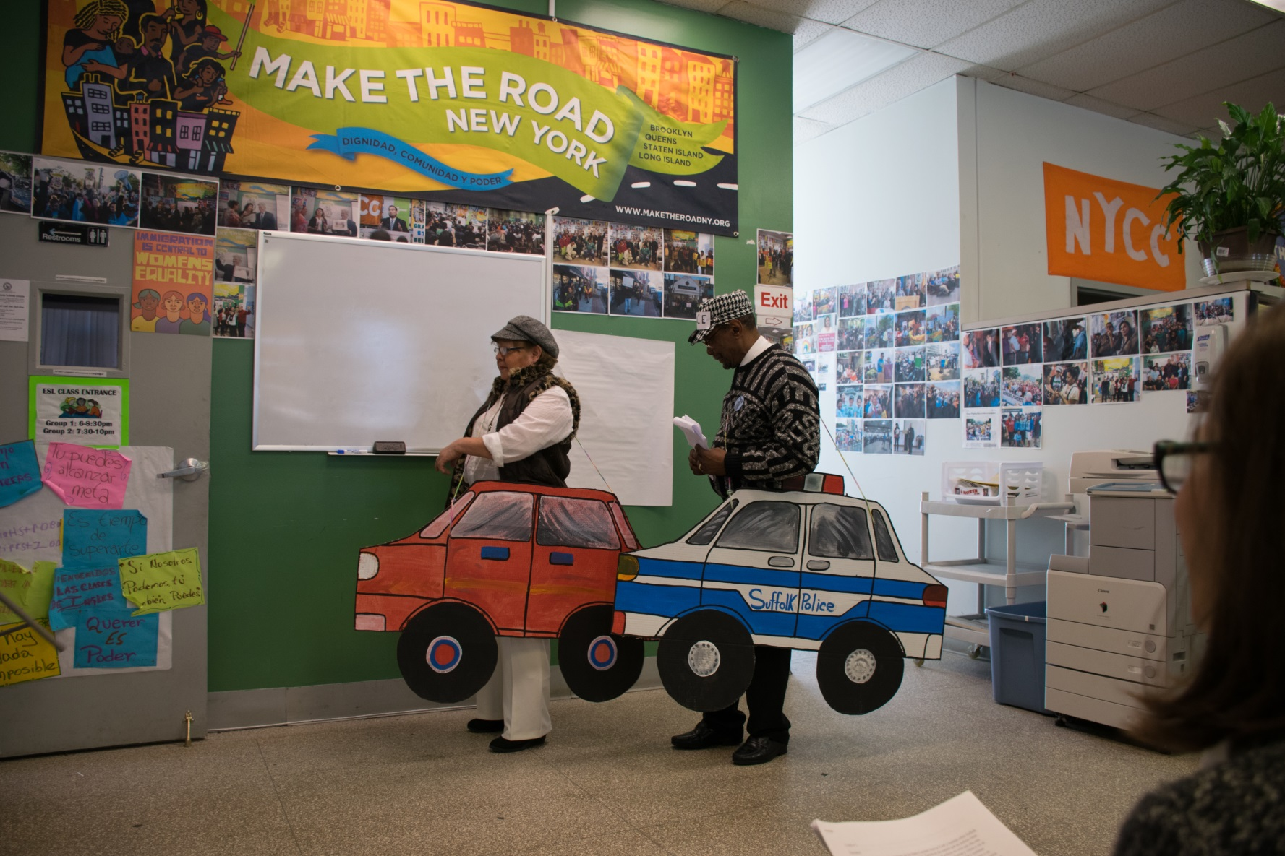
Know your rights!

Slide 16
How to Improve Language Access: Test and Report Back
Know Your Rights Trainings! Get the word out on the LAP and services for LEP.
Testing the System:
Call the complaint/compliment line: 631-775-2077.
Go to the precincts and ask for assistance.
Did they try to talk you out of filing a complaint? Did they tell you to come back another day regarding your request?
Did they decline to call an interpreter, despite a request for one, citing that they could understand your English?

Slide 17
Further Reading:
http://apps.suffolkcountyny.gov/police/information.htm
http://www.lep.gov/
http://www.lep.gov/faqs/FAQ_About_LEP_Title_VI_and_Title_VI_Regs.pdf
http://www.lep.gov/resources/2011_Language_Access_Assessment_and_Planning_Tool.pdf
http://www.justice.gov/sites/default/files/crt/legacy/2010/12/14/LEPKYR_Spanish.pdf

