Slide 1
Objectives
  To review Language Access regulations and services available for improving communication for people with limited English proficiency
  To heighten awareness of Cultural Competence and Diversity and Inclusion and learn how these principles are integrated into our personal and professional lives
  To improve ability to work across differences and gain guidance in assuring meaningful access to linguistic and cultural minorities

Slide 2
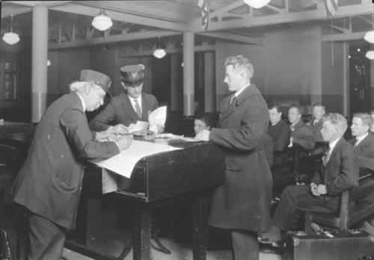
Con(de)struction of the Language Barrier
1892-1950’s Ellis Island
1964 Title VI Civil Rights Act
1986 Office of Minority Health was founded
2000 CLAS standards first published
2010 The Affordable Health Care for America Act (H.R. 3692)
2011 The Joint Commission Advancing Effective Communication, Cultural Competence, and Patient- and Family-Centered Care: A Roadmap for Hospitals
2013 CLAS standards enhanced
This scene would not be possible without him. He is the connecting link between the American clerk and the European immigrant, between the New World and the Old World. His role as mediator makes him the central figure.
Who is he?

Slide 3
Language Access and Cultural Competence
Lillian M. Moy, Executive Director
Legal Aid Society of Northeastern New York
55 Colvin Avenue, Albany, NY 12206
518-689-6304/518-427-8352 (fax) lmoy@lasnny.org
Celina Ramsey, MSHC, Language, Health Literacy & Diversity Coordiantor
Staten Island University Hospital
718-226-8435/718-226-6842 (fax) cramsey@siuh.edu

Slide 4
Why We Can’t Wait
:”The limits of my language are the limits of my world.”
        Ludwig Von Wittgenstein

Slide 5
Quick Self-Assessment
Do clients bring their own interpreter?
Training on how to interpret for staff interpreters
Training on how to work with interpreters
Written LEP policy
Intake Database has mandatory language fields
Sends letters in English only to non-English speakers
Vital documents translated
Are you aware of how your own cultural biases affect your services to clients/students?

Slide 6
Legal Imperatives
VI of the Civil Rights Act of 1964, 42 USC Sec. 2000d
Executive Order 13166
DOJ Guidance
LSC Program Letter 04-2
ABA Standard 4.6
Ethical obligations/malpractice
https://www.thinkculturalhealth.hhs.gov/Content/clas.asp

Slide 7
National Standards for Culturally and Linguistically Appropriate Services: CLAS
The CLAS standards are designed to educate and inform practices to
Advance health equity
Improve quality
Help eliminate health care disparities
Principal Standard:
1. Provide effective, equitable, understandable, and respectful quality care and services that are responsive to diverse cultural health beliefs and practices, preferred languages, health literacy, and other communication needs.
Standards 2-15:
Leadership supports CLAS
Policy and governance created
Workforce Diversity
Workforce educated on CLAS
Communication and Language Access meet diverse needs*
Continuous assessment and monitoring of demographical data
Community programmatic partnership
Conflict resolution process
Communicate progress

Slide 8
Limited English Proficiency (LEP)
Limited English Proficient (LEP)
The term “limited English proficient” means that an individual cannot speak, read, write, or understand the English language at a level that permits him or her to interact effectively
Language Access Services
Language access services is the collective name for any service that helps an LEP person obtain the same access to and understanding as an English speaker would have. Language access services can include the use of bilingual staff and interpreters, as well as the provision of translated documents
Interpreting
The process of understanding and analyzing a spoken or signed message and re-expressing that message faithfully, accurately and objectively in another language, taking the cultural and social context into account
Translation
The conversion of written text into a corresponding written text in a different language

Slide 9
Ten Commandments of Cultural Competence
The Guiding Principles of Client Service
The Legal Aid Society of Northeastern New York

Slide 10

I
Know Thyself … as a Cultural Being
Cultural Identities
Subject to change and contradictions
Culture is like the air we breathe
Similarities and differences

Slide 11
What is Cultural Competence?
Cultural competence is a set of attitudes, skills, behaviors, and policies that enable people to live and work effectively in cross-cultural situations
It reflects our ability to gain and use knowledge of beliefs, attitudes, practices and communication styles to improve services, communication, and participation among diverse populations
Inclusion: Acceptance of people’s differences

Slide 12
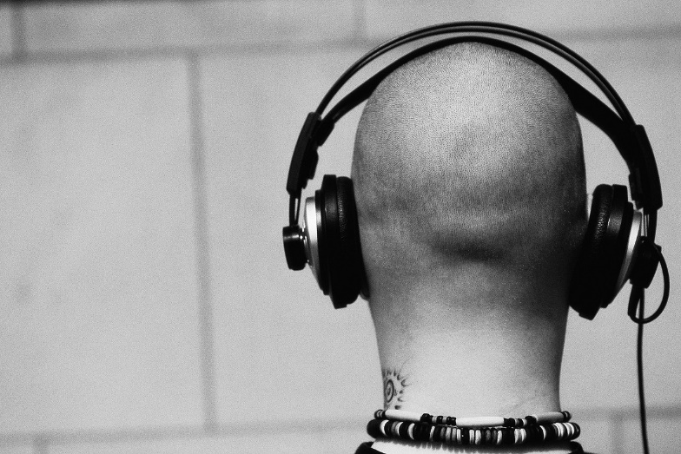
II
Listen, Listen, Listen
Deeply
Focus on content, not style
On words and non-words
Non-verbal behavior

Slide 13
Body Language and Non-verbal Cues
DIRECT EYE CONTACT - Asians, Puerto Ricans, West Indians, African Americans & Native Americans considered it to be rude, disrespectful, or intimidating; for Latinos- authority and for Muslims- gender
BECKONING - Europeans and Asians raise the arm, palm facing down, and make a scratching motion with fingers
THE O.K GESTURE- In France it means zero. In Japan it means money or coins. In Brazil, Germany, and the former USSR., it is an obscene gesture
THUMBS UP- Also used for hitch-hiking in America. In Nigeria its a rude gesture. In Germany and Japan it is the signal for "one”
NODDING AND SHAKING YOUR HEAD- Has the opposite meaning in Bulgaria, parts of Greece, Yugoslavia, Turkey, Iran, and Bengal
Speaking Volume- Americans, African Americans and Latinos speak in high volume to exhibit anger or excitement, Asian and Western European generally speak with lower volume
Others: Smiling, Time and Silence

Slide 14
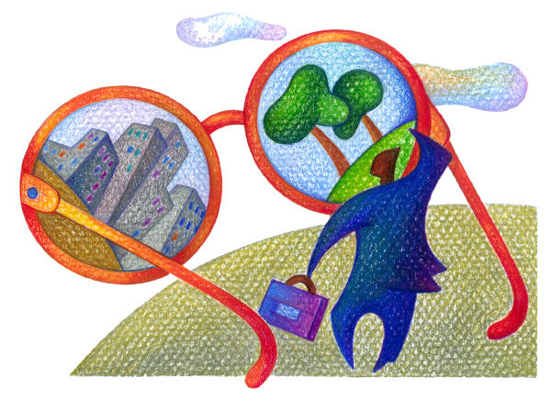
III
Learn What You Don’t Know
Training and information on general concepts and specific culture

Slide 15
How close is too close for comfort?
Personal space and the “Comfort Zone”: how close you stand, sit or walk with someone varies by culture, varies inter-culturally, by gender, status, intimacy, relationship, and space available
Americans prefer to stand about 2-4’ apart when speaking
German and Japanese cultures like to have more distance
Arabic and Latino cultures generally like to get closer to the speaker

Slide 16
IV
But Never, Ever Stereotype
No single characteristic fully defines you or your client’s culture
Make gentle use of knowledge
Focus on gathering facts

Slide 17
V
Stop, Look and Reflect
Develop capacity to debrief and reflect

Slide 18
VI
Avoid Judgments
Parallel universes
Imagine multiple possible meanings

Slide 19


VII
R-E-S-P-E-C-T
Avoid stereotype
Client’s values, not ours

Slide 20
VIII
Talk About It!
We have to be willing to talk about issues of difference and issues of similarity
Strategize about it

Slide 21

IX
Stay Awake
Pitfalls, red flags and remedies

Slide 22
Tactile (Touching) Communication
Compared to other cultures, Americans rarely touch each other, limiting ourselves to handshakes and occasional pats on the shoulder or arm in business relationships, or hugs in closer friendships, unless your family is from a touching culture
Latin Americans and Middle Easterners touch with much greater frequency. In these cultures, it is not uncommon for two men to hold hands, signifying nothing more than friendship
Certain other groups, such as the Japanese, touch less than Americans and may be uncomfortable being touched in a casual relationship
People from cultures with conservative customs regulating inter-gender relationships may be extremely uncomfortable being touched by someone of the opposite sex
Touching someone on the head is offensive to most Asians
© 2008 Diversity Council: http://www.diversitycouncil.org/toolkit/Resources_TipSheet_NonverbalCrossCulturalCommunication.pdf

Slide 23
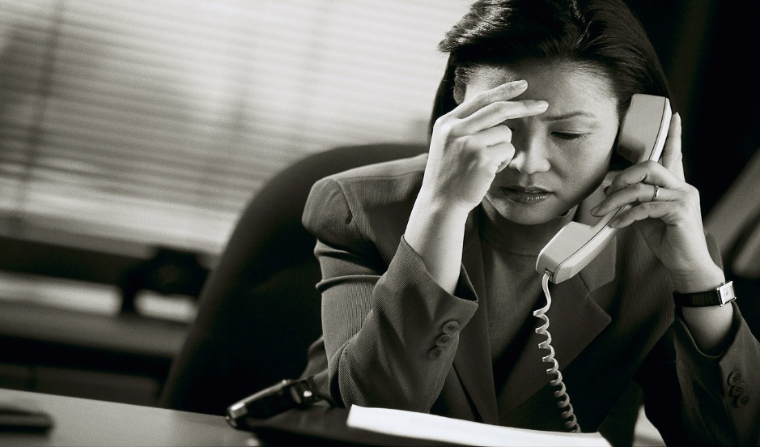
X
Honor Thyself … As a Human Being
Decrease stress so that bias and stereotype are less likely to govern.

